Slide 1
Regression using LightGBM
Muthukumaran

Slide 2
What is LightGBM
LightGB is an open-source gradient boosting framework designed for efficient and scalable machine learning. It works for both structured and unstructured data and is optimized for speed and memory usage.
Handles large datasets with millions of rows and columns
Supports parallel and distributed computing
Uses histogram-based techniques and leaf-wise tree growth for efficiency
Provides options like Exclusive Feature Bundling (EFB) and Gradient-based One-Side Sampling (GOSS) for faster computation and reduced memory usage

Slide 3
Installation and syntax
!pip install lightgbm
import lightgbm as lgb
model = LGBMRegressor(metric='rmse')
model.fit(X_train, Y_train)

Slide 4
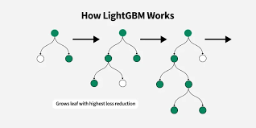
Image Explanation

Slide 5
